Slide 1
Emergency Management for Judicial Related Offices
Plans, Lessons Learned, and the Path Forward
Statewide Webinar
Justice Administrative Commission
November 30, 2017

Slide 2
Overview
Emergency plans all offices should consider
Seven key planning elements and 40 plus action items
Lessons learned from 2017 hurricane season
Why this is important and our path forward

Slide 3
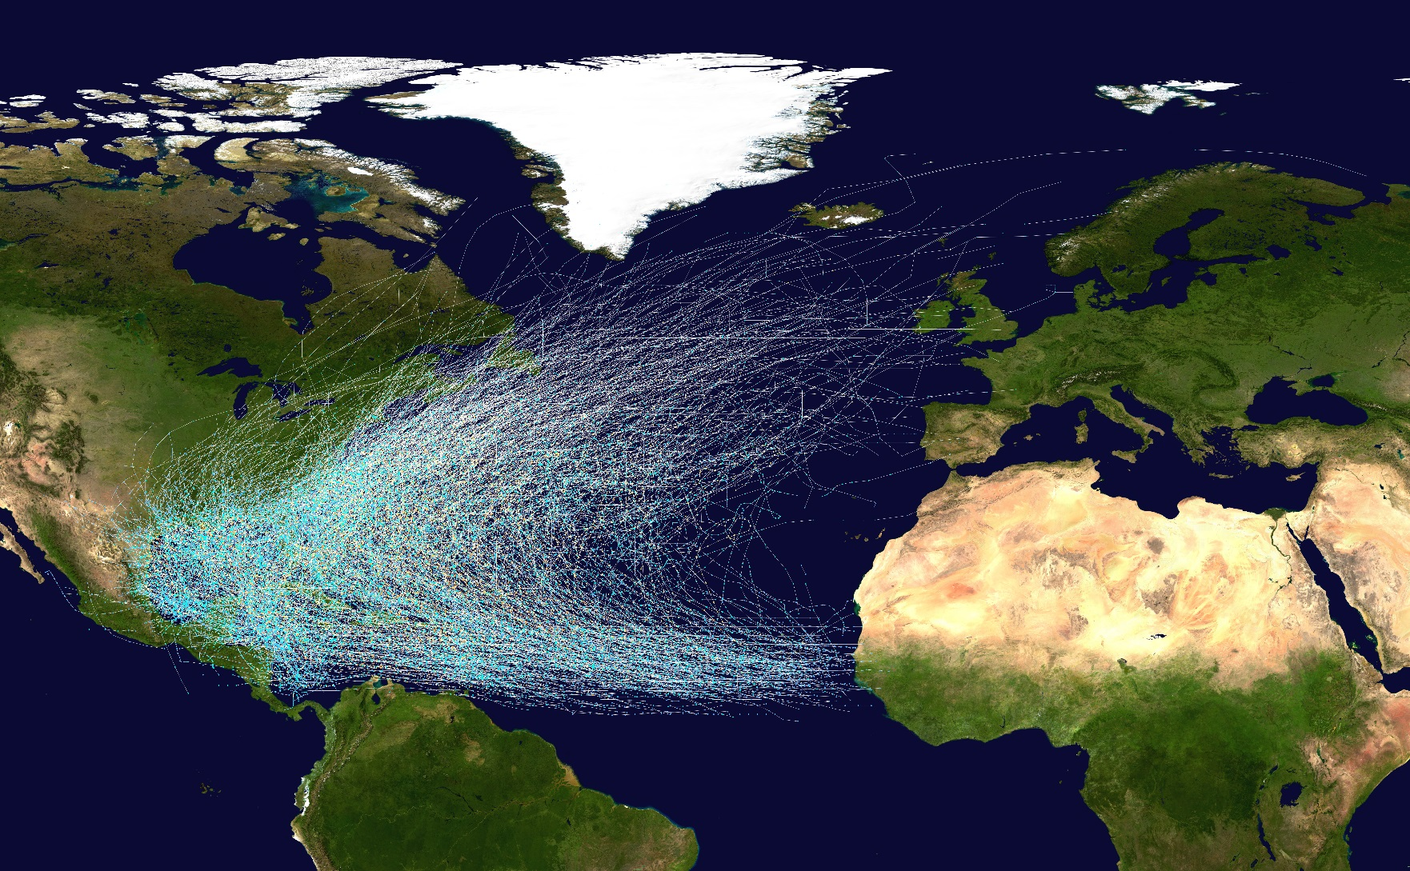
Historic Hurricane Tracks

Slide 4

Historic Hurricane Tracks

Slide 5
Occupant Emergency Plan
Initial Response to Emergencies Will be Outlined and Should be Followed Based on the Occupant Emergency Plan
An Individual or Group will make an Initial Assessment as to Whether or Not the Primary Facility Needs to be Closed
Emergency Pending or Occurs
COOP
Does Emergency Cause
the Closure of Primary
Facility?
Initial Response to Emergencies Will be Outlined and Should be Followed Based on the Occupant Emergency Plan
An Individual or Group will make an Initial Assessment as to Whether or Not the Primary Facility Needs to be Closed
Immediately
Does Emergency Cause
the Closure of Primary Facility?
No
Yes
Handle the Emergency Situation as Outlined in the Occupant Emergency Plan
Yes
Is the Length of the Closure Minimal and Acceptable?
No
Address Emergency and Resume Full Operations in Primary Facility
Address Emergency and Resume Full Operations in Primary Facility
COOP
Is the Length of the Closure
Minimal and Acceptable?
Note: Occupant Emergency Plans are also known as Evacuation Plans, Emergency Incident Plans, Administrative and Emergency Procedures, Emergency Action Plans, and numerous other titles.
Handle the Emergency Situation as Outlined in the Occupant Emergency Plan
Address Emergency and Resume Full Operations in Primary Facility
Address Emergency and Resume Full Operations in Primary Facility
Notes:
5

Slide 6
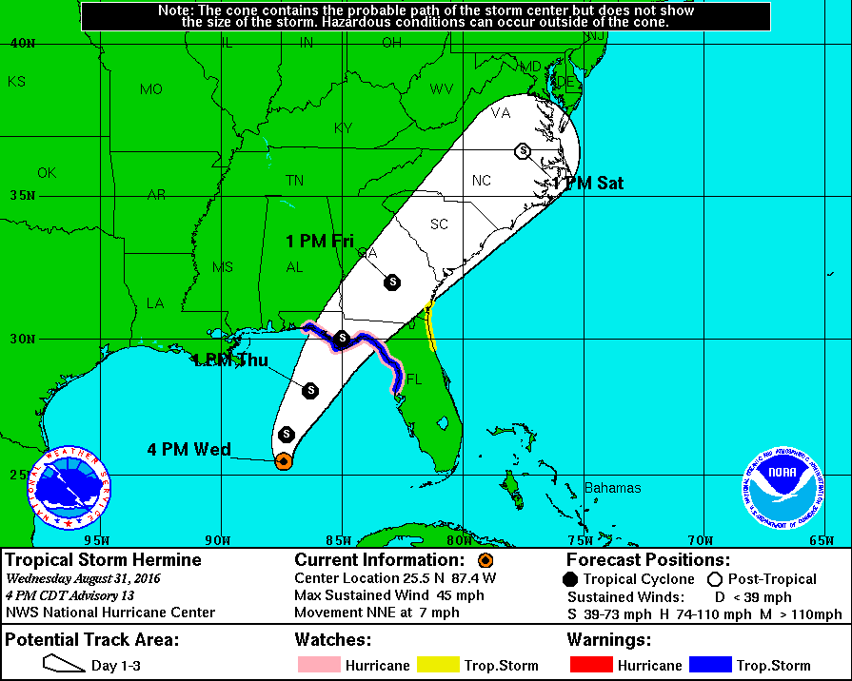
Hurricane Hermine – September 2016
Wednesday, August 31
at 4:00 PM CDT
Closed Thursday and Friday
  Local schools
Open Thursday
  Florida Supreme Court
  First District Court
  Second Circuit Court
  State Attorney
  Public Defender
Our decision…
  Open on Thursday
  Annual leave approved
Projected Landfall: Thursday night
Notes:
1. Leon and Wakulla schools closed for Thursday and Friday.
2. Florida Supreme Court is open on Thursday and oral arguments are scheduled.
3. First DCA and Second Circuit are open on Thursday.
4. Second Circuit State Attorney and Public Defender are open on Thursday.
5. JAC is open on Thursday. Earlier on Wednesday, Rip had granted approval for staff to take annual leave to prepare for the storm, for safety considerations, or to take care of children. He extending this annual leave option to all day on Thursday and Friday.

Slide 7
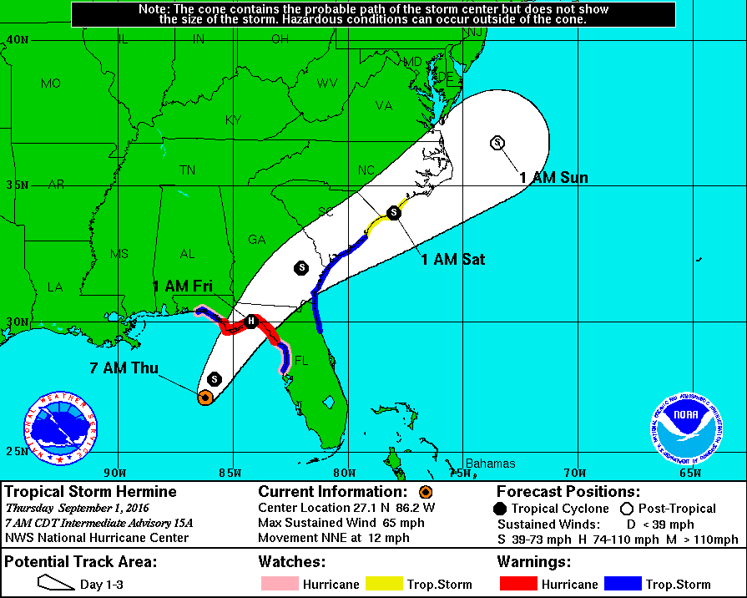
Hurricane Hermine – September 2016
Thursday, September 1
at 7:00 AM CDT
Closing 12:00 PM EDT
  Impacted state offices
  Friday status still pending
Our decision…
  Close 12:00 PM EDT for Thursday
  Friday status still pending
  Administrative leave granted for Thursday afternoon
Projected Landfall: Thursday night or early Friday morning

Slide 8
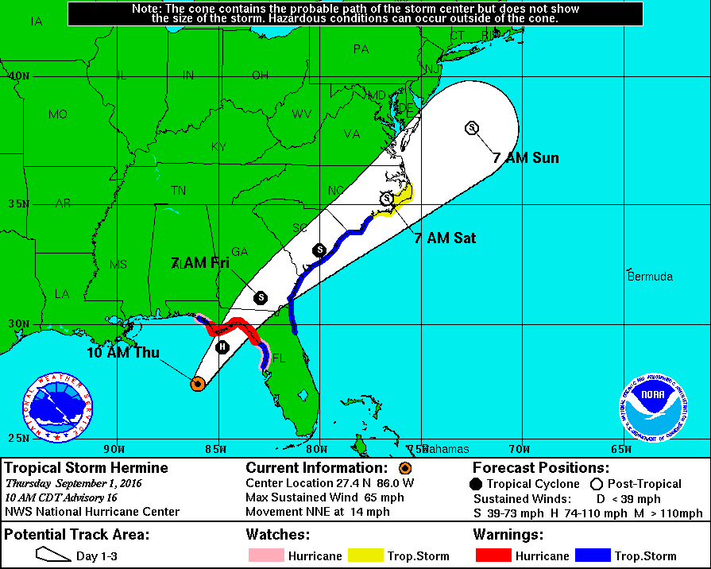
Hurricane Hermine – September 2016
Thursday, September 1
at 10:00 AM CDT
Closing 12:00 PM EDT and all day Friday
  Florida Supreme Court
  First District Court
  Second Circuit Court
Our decision…
  Close Friday in addition to Thursday afternoon
  Administrative leave extended to Friday
Projected Landfall: Thursday night or early Friday morning

Slide 9
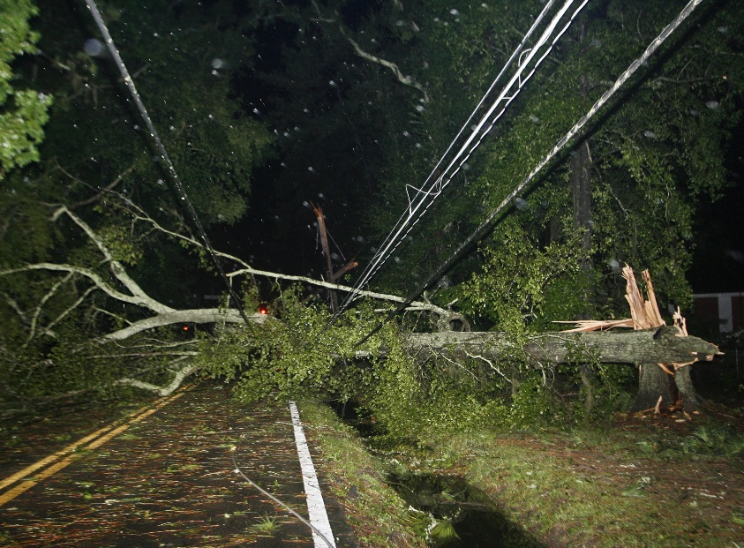
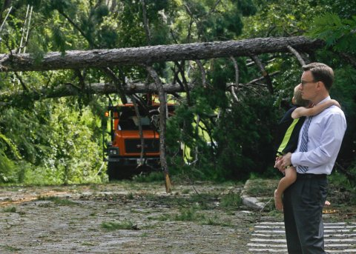
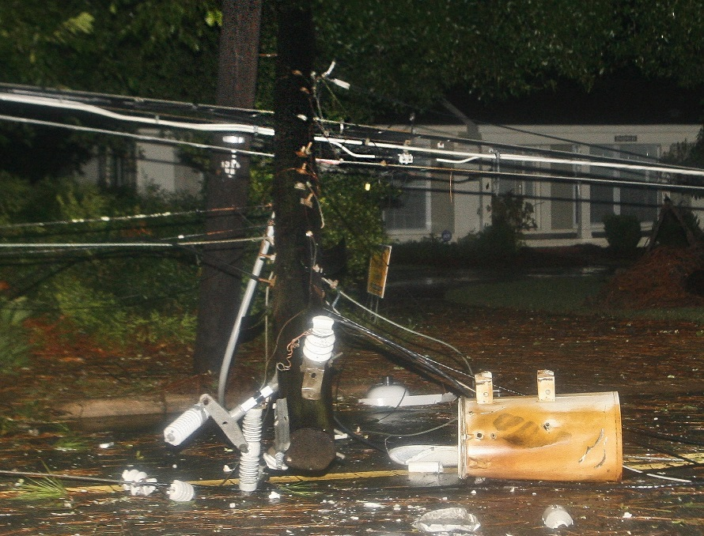
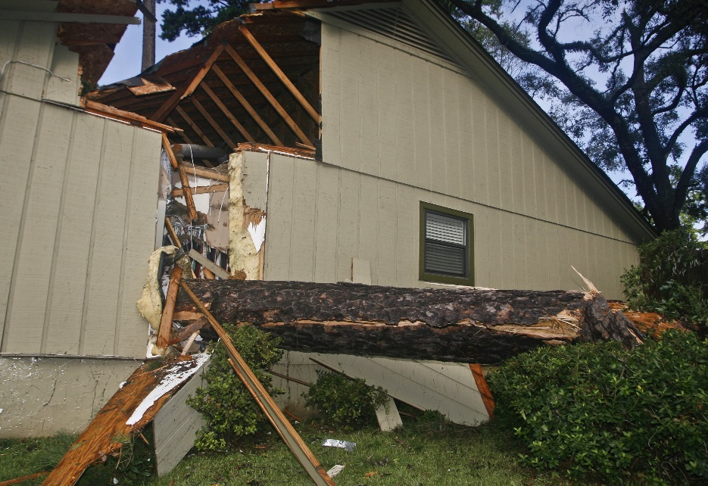
Hurricane Hermine – September 2016
Tallahassee Democrat
Notes:
Hermine makes landfall Thursday night/Friday morning. Damage was extensive in Tallahassee, but JAC survived unscathed. Monday, September 5 was Labor Day, and JAC reopened on Tuesday, September 6.

Slide 10
Continuity of Operations Plan (COOP)
Activate COOP and Begin the Process toward Performance of Mission Essential Functions in a Predetermined and Temporary Alternate Facility
Perform Mission Essential Functions under the COOP on a Temporary Basis
An Individual or Group will Assess Whether or Not Full Operations in the Primary Facility can be Reconstituted within 30 Days of COOP Activation
Immediately Begin Efforts to Reconstitute Full Operations within 30 Days in a Long-Term Alternate Facility
COOP
An Individual or Group will Assess Whether or Not Full Operations in the Primary Facility can be Reconstituted within 30 Days of COOP Activation
Can Full Operations in Primary Facility be Reconstituted in 30 Days?
Activate COOP and Begin the Process toward Performance of Mission Essential Functions in a Predetermined and Temporary Alternate Facility
Immediately
Yes
Can Full Operations in
Primary Facility be
Reconstituted in 30 Days?
No
Perform Mission Essential Functions under the COOP on a Temporary Basis
Perform Mission Essential Functions under the COOP on a Temporary Basis
Immediately Begin Efforts to Reconstitute Full Operations within 30 Days in a Long-Term Alternate Facility
Transfer Back into Full Operations in the Primary Facility
Full Operations in a Long-Term Alternate Facility Initiated within 30 Days
Perform Mission Essential Functions under the COOP on
a Temporary Basis
Full Operations in a Long-Term Alternate Facility Initiated
within 30 Days
Note: IT Business Continuity Plans must be developed to support COOP implementation.
Transfer Back into Full Operations in the Primary Facility
Notes:
10

Slide 11
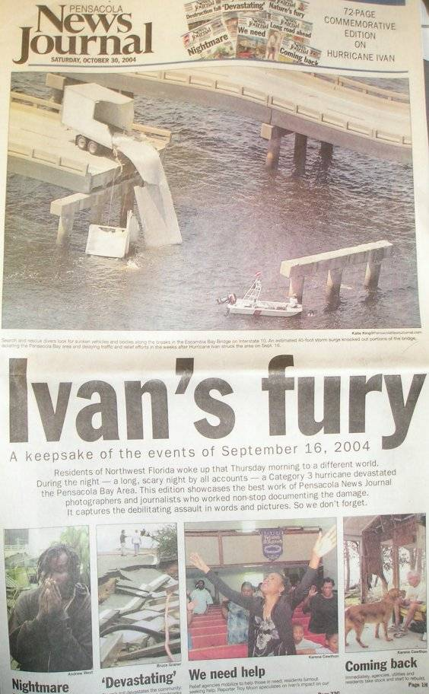
Hurricane Ivan – September 2004
Pensacola News Journal
Thanks to Shelia Sims

Slide 12
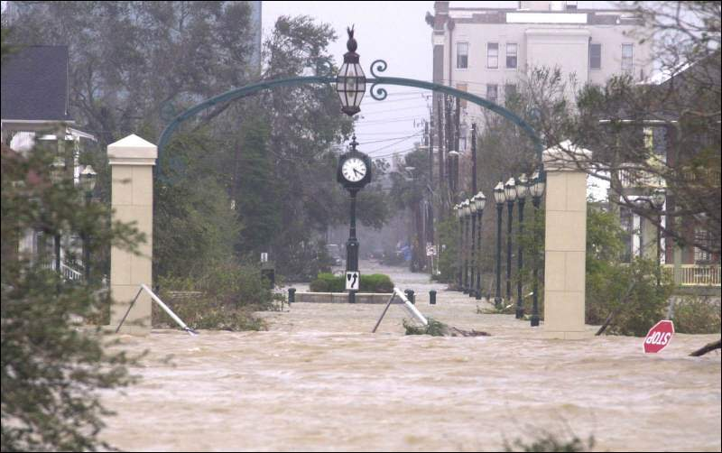
Hurricane Ivan – September 2004
Pensacola News Journal
The Downtown Streets of Pensacola Florida
Thanks to Shelia Sims

Slide 13
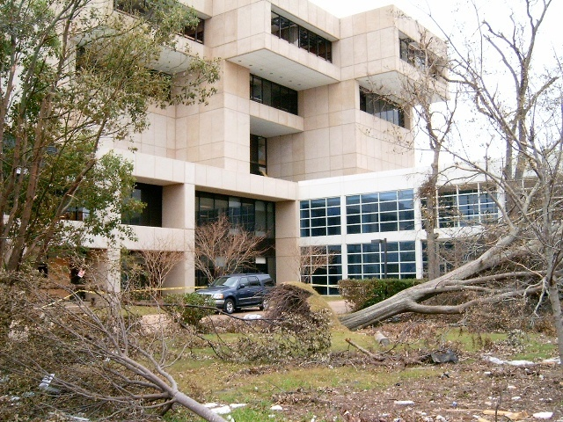
Courthouse Damage
M.C. Blanchard Courthouse in Pensacola Florida
Thanks to Shelia Sims

Slide 14
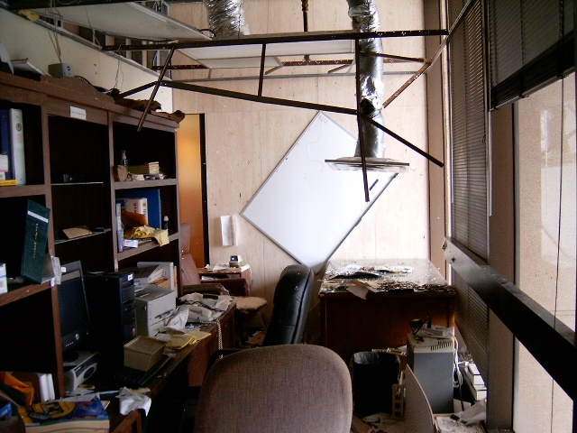
Courthouse Damage
M.C. Blanchard Courthouse in Pensacola Florida
Thanks to Shelia Sims

Slide 15
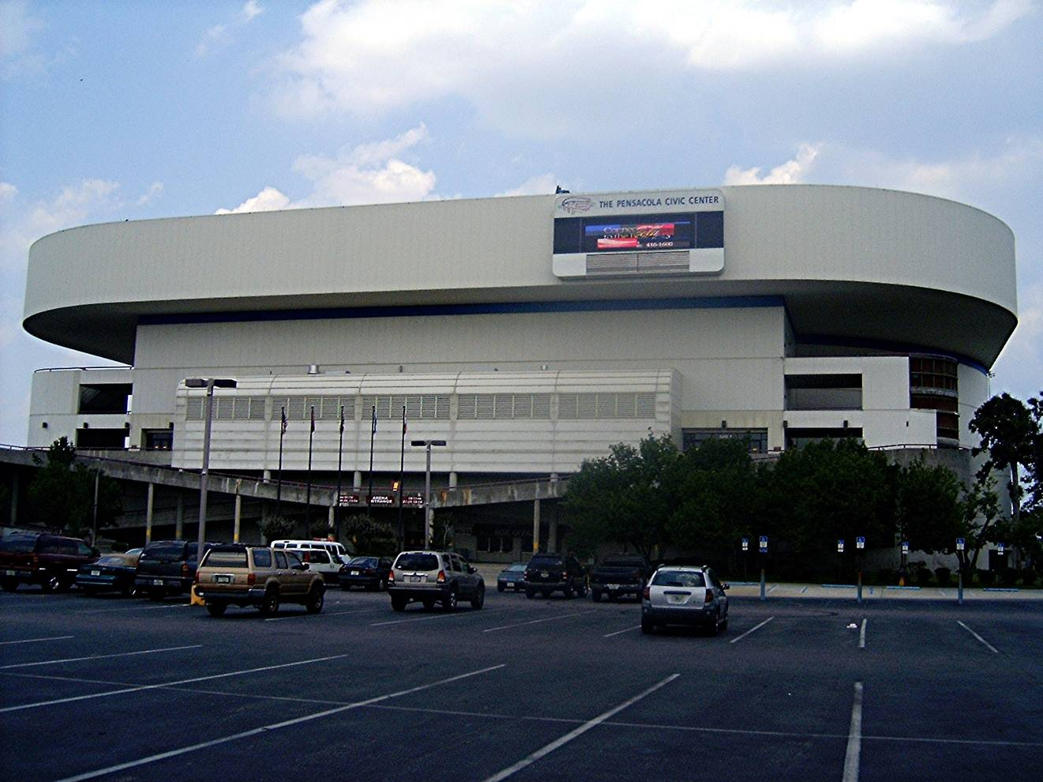
Alternate Facility
The Pensacola Civic Center
Thanks to Shelia Sims

Slide 16
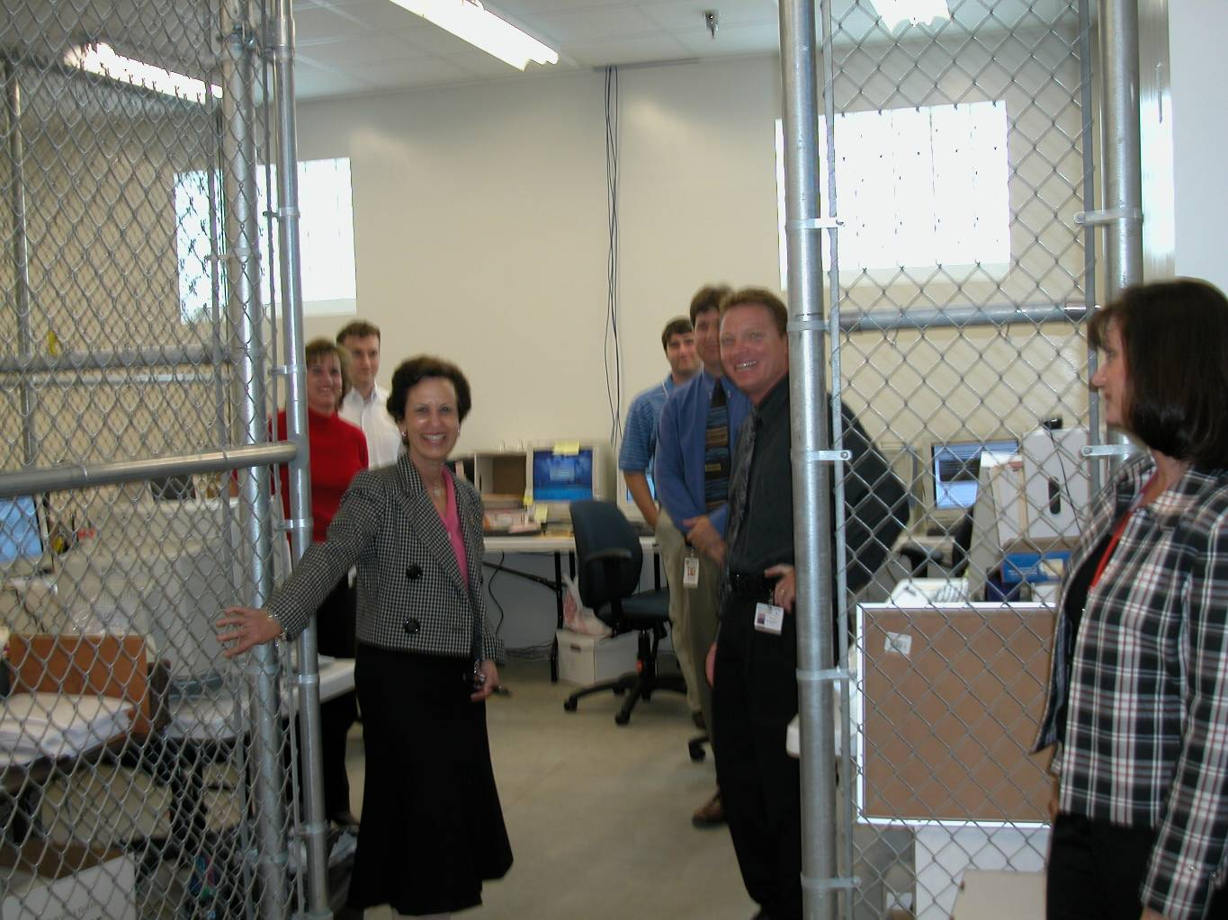
Mission Essential Functions at the Alternate Facility
Justice Barbara J. Pariente Reviews the Response to Hurricane Ivan
Thanks to Shelia Sims

Slide 17
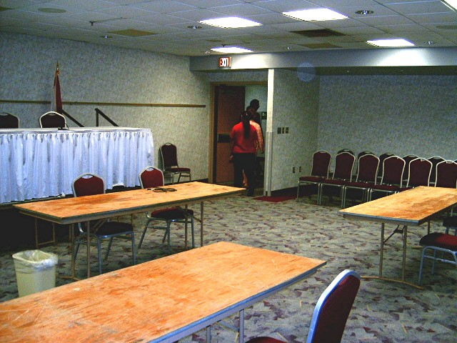
Courtrooms at the Alternate Facility
Courtroom with Jury Box at the Alternate Facility
Thanks to Shelia Sims

Slide 18
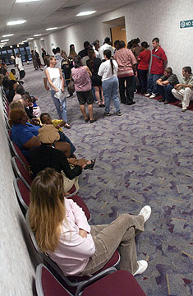
Hallways at the Alternate Facility
Courts are Open at the Civic Center in Pensacola Florida
Pensacola News Journal
Thanks to Shelia Sims

Slide 19
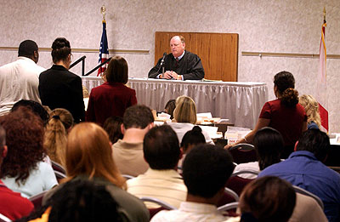
Courtrooms at the Alternate Facility
Pensacola News Journal
Judge Thomas Johnson Holds Court at the Alternate Facility
Thanks to Shelia Sims

Slide 20
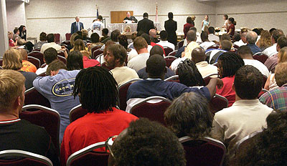
Courtrooms at the Alternate Facility
Pensacola News Journal
Judge Thomas Johnson Holds Court at the Alternate Facility
Thanks to Shelia Sims

Slide 21
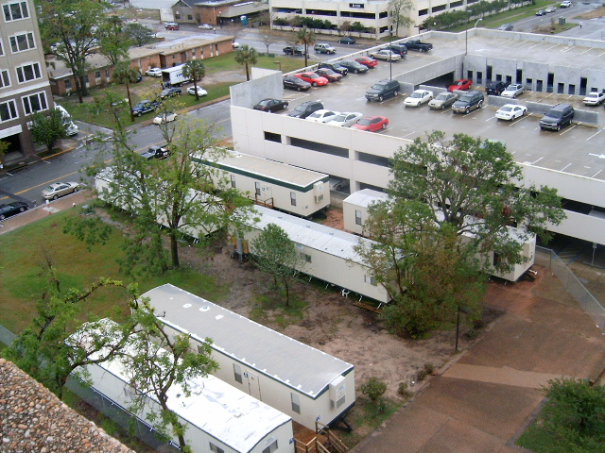
Long-Term Alternate Facilities
Judicial Trailer Park
Thanks to Shelia Sims

Slide 22
Seven Key Elements of Court Emergency Planning
Address leadership issues
Dedicate staff
Build and strengthen collaborative relationships
Develop redundant communications
Develop a self-sufficient workforce
Write the plans
Test, exercise, and maintain
“Plans are worthless, but planning is everything.”
-- Dwight D. Eisenhower
The seven elements are further broken down into 40 plus action items
Note: These key elements are based on guidance published by the National Center for State Courts
following Hurricane Sandy.

Slide 23

Esc for More Detail…
40 Plus Action Items
Lessons Learned in
2017 Hurricane Season

Slide 24
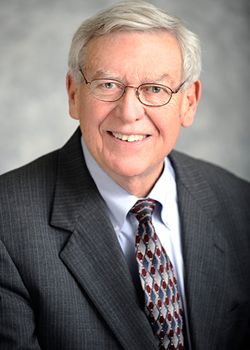
Policy Consideration
Policy Goals for the Florida State Courts
We must deal with crises in a way that protects the health and safety of everyone inside our facilities.
We must “keep the courts open” to ensure justice for the people.
Former Chief Justice Charles T. Wells

Slide 25
Your Input and Questions
Greg Cowan
greg.cowan@justiceadmin.org
(850) 488-2415, ext. 229

